Slide 1
The Fourth Plinth Schools Awards 2018
Design a piece of artwork to be displayed on the 4th Plinth in Trafalgar Square
Greatfields School has been invited to enter the competition.
Hosted by the Mayor of London and the Arts Council England.

Slide 2
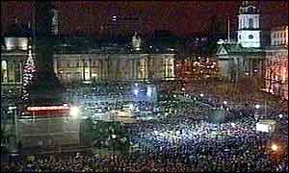
The Fourth Plinth in Trafalgar Square
Have you heard of Trafalgar Square?
Trafalgar square is a huge public square in central London.
Visited by approximately 18 million people each year.
There are lots of public events held throughout the year at the Square.
It is a historical sight and a symbol of London.
Surrounded by key places: National Gallery, National Portrait Gallery, St James’ Park, The Strand and close to Leicester Square.

Slide 3
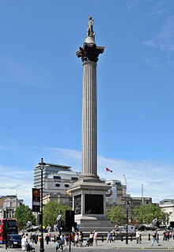
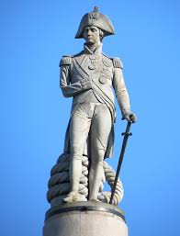
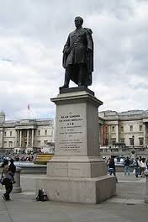
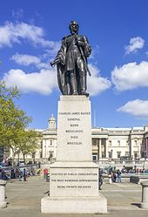
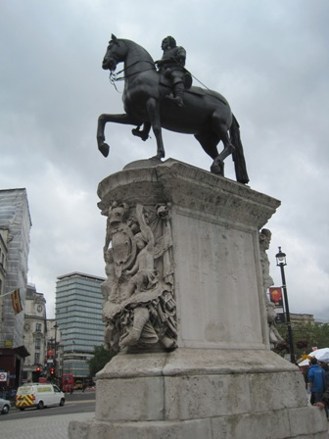
Statues and The Fourth Plinth in Trafalgar Square
The most famous statue is Nelson’s Column.
In each corner of the square is a plinth. 3 plinths have permanent statues the 4th plinth is left to show pieces of artwork each year.

Slide 4
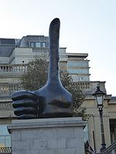
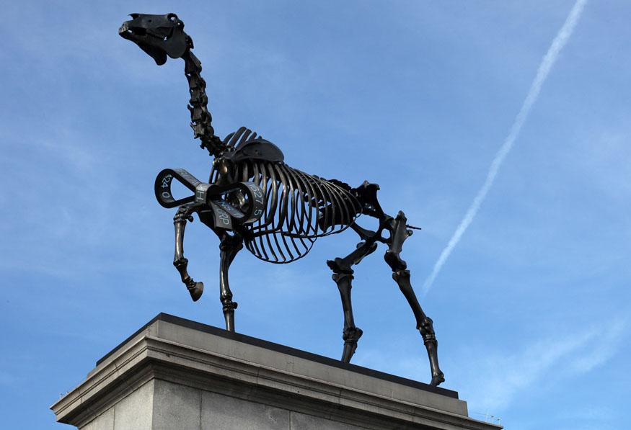
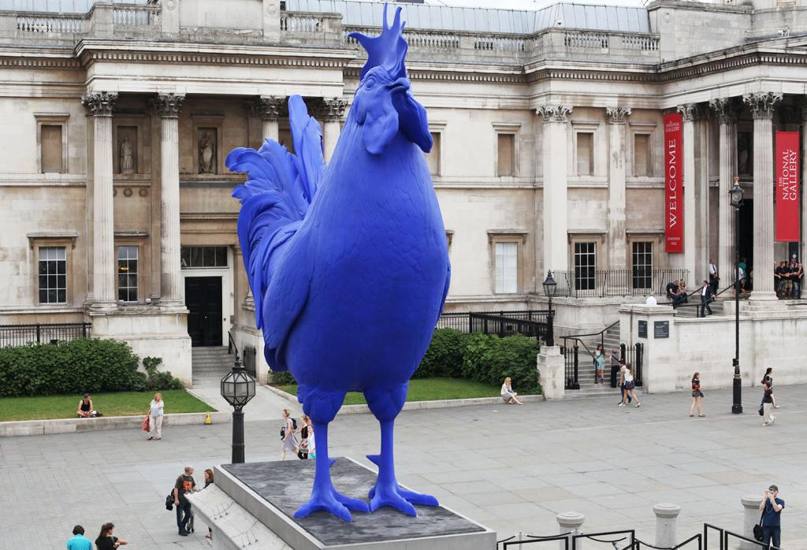
The Fourth Plinth in Trafalgar Square
The Mayor of London chooses artwork to display on the 4th Plinth in the Square.
Hans Haacke,
“Gift Horse” 2015- 2016
Katharina Fritsch,
“Hahn/Cock” 2013- 2015
David Shrigley,
“Really Good” 2016-present
What is life in London like?

Slide 5
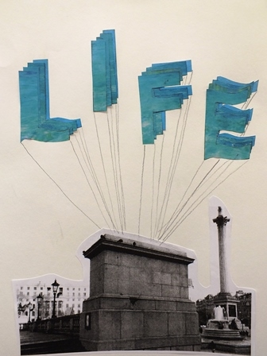
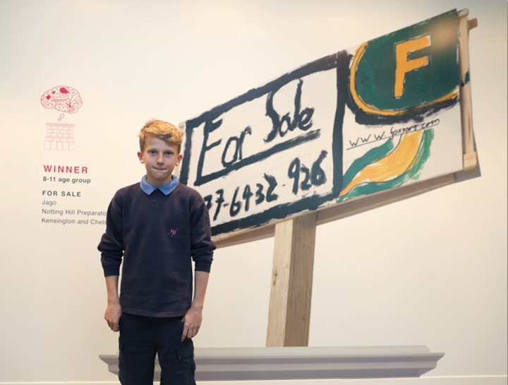
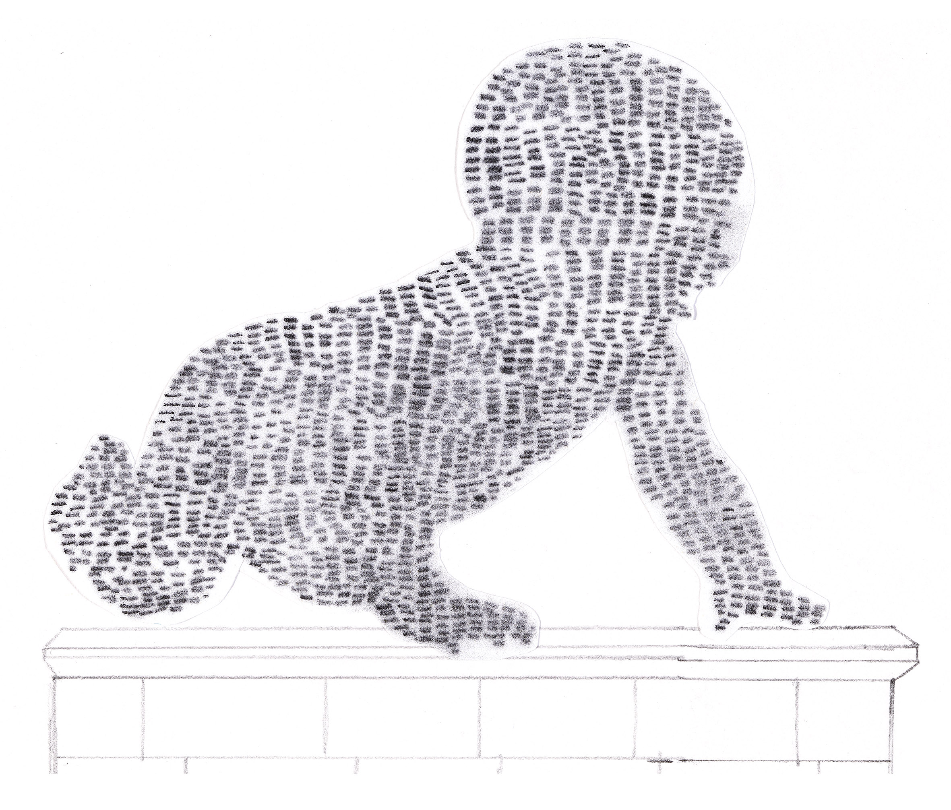
Design something for the 4th Plinth
Create a design to express your view of life in London
highlight a concern of living in London
celebrate life in London and Barking
“Skull” 2016, 14 year old, Card and paint.
“Tech baby” 2016, 12 year old, Drawing of a baby made out of mobile phones from around the world.
“For Sale”, 2015, 11 year old, Painting,
“Life”, 2015, 13year old, Painted design of balloons

Slide 6
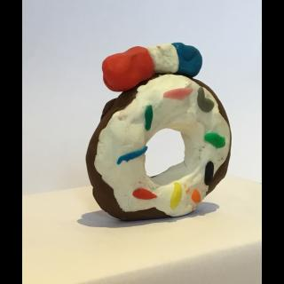
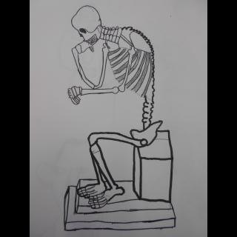
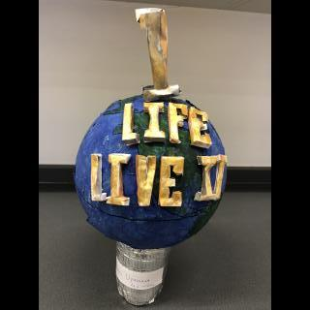
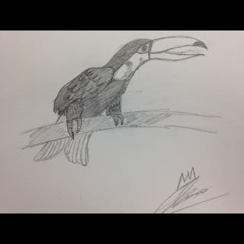
Create a design to express your view of life in London

Slide 7
Competition details
Dream it. Believe it. Achieve it.
Three age groups: 5-7years, 8-11years; and 12-15years
1 winner and 1 runner up from each age Group.
One winner from each Borough. 33 Boroughs in London.
We are in Barking and Dagenham
Total of 39 winners.
Prizes:
Artwork displayed in an exhibition at City Hall during summer.
Invited to an award ceremony at City Hall.
£100 worth of Art materials for you and Art materials for your school.

Slide 8
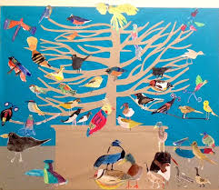
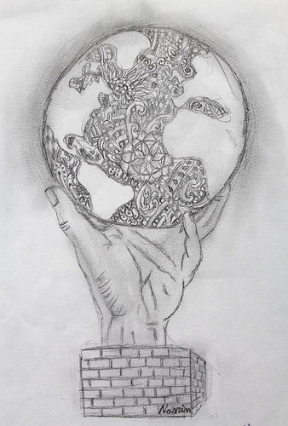
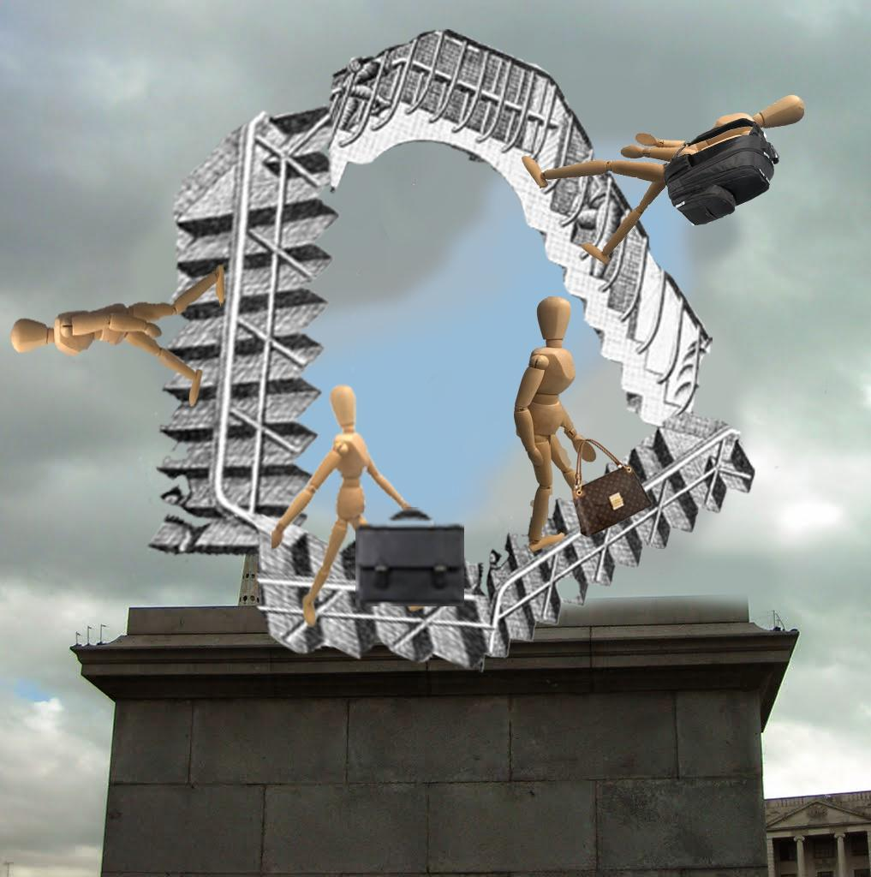
Competition details
Enter as individual or as a group
Draw, paint or make.
Take an photo of your design
Collect an entry pack this week.
Deadline is Thursday 8th March
Next Thursday come to Art Club = with competition designs or to use materials.
Ask Miss Knight for help. Come to the art room after school.
Don’t leave it until the day before the deadline.
Thursday 8th March!

