Slide 1
Year 6 Induction Evening
Tuesday 18th July 2017

Slide 2
Great teaching
A culture of positive behaviour
Aspiration for all
Community

Slide 3
Great teaching
An engaging curriculum
Challenge, challenge, challenge
Subject specialists

Slide 4
The curriculum
Maths (4 hours)
English (4 hours)
Science (3 hours)
Spanish (2 hours)
Art (2 hours)
PE (3 hours)
History (2 hours)
Geography (2 hours)
Performing Arts (2 hours)

Slide 5
A culture of positive behaviour
High expectations
Clear routines
Mutual respect between staff and students
Celebration of success
Clear systems and sanctions in place

Slide 6
Aspiration for all
High ambition for ALL of our students
Two hour career workshop for all students, every year
Outside speakers
Visits to universities

Slide 7
Pathways
Five teaching groups based on prior attainment:
7 Moore (Booby Moore)
7 Jamu (Inder Singh Jamu)
7 Kangethe (Elizabeth Wanjiku Kangethe)
7 Gull (Beverley Gull)
7 Todd (Ron Todd)

Slide 8
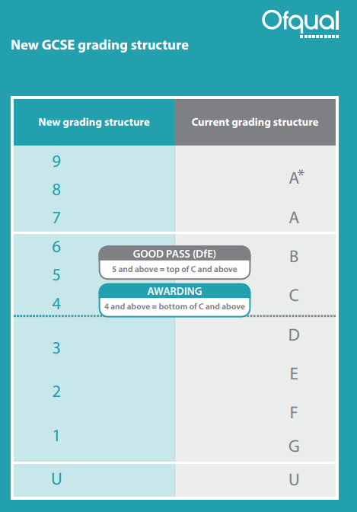
New GCSE grades

Slide 9
Assessment
Students will take a baseline assessment in English and Maths at the start of Year 7
Four Tracking Assessments each year:
October half term
End of Christmas term
End of Easter term
End of summer term (end of year exam)
These Tracking Assessments will be used to track students’ progress towards their Year 11 targets.
The assessments are monitoring progress and are not high stakes exams.

Slide 10
Homework
Homework is set in every subject every week
All homework is set on Show My Homework – please check this regularly
There are a number of different types of homework which will be set every week

Slide 11
Reporting to parents
Parents will be sent a report after each Tracking Assessment
The report will not contain grades or target grades
The report will contain written targets for improvement in each subject
For example:
Maths: “Omari needs to revise how to find the ares of a triangle”
Spanish: “Mary needs to revise her irregular verbs”

Slide 12
Enrichment
Enrichment clubs 3-4pm every day:
Sports clubs:
Boys’ and girls’ football, tag rugby, netball, boxing
Art Club
STEM Club
Drama Club
Dance Club
Debate Mate
Student newspaper
Coding Club
Homework Club
Choir
Cooking Club

Slide 13
Boys’ football team won league and borough cups
Girls’ football, netball and rounders team competing in borough competitions
Whole school trip to Tate Modern Gallery
Todd and Gull visit to the Technical Skills’ Academy in Barking
Maths masterclass at Birkbeck University
Trips to Sussex and Cambridge universities
Wicked at the West End
Art exhibition at Studio 3 Arts

Slide 14
Attendance
High attendance is absolutely crucial to your child’s success in school
If students are not in school they cannot learn
1 day per week missed = 5 hours per week = 70 hours per term = 210 hours per year = 1050 hours by GCSEs
1 day per month missed = 5 hours per month = 20 hours per term = 60 hours per year = 300 hours by GCSEs
School target is 98% = 2 days absence all year, per student
Rewards and badges for 100% attendance
If your child is not going to be in school you must ring the school to inform us why they will be absent.

Slide 15
The school day
8.40 | Registration
9.00 | Period 1
10.00 | Period 2
11.00 | Lunch
11.30 | Period 3
12.30 | Period 4
1.30 | Second break
2.00 | Period 5
3.00 | Enrichment clubs

Slide 16
EAL lessons

Slide 17
Communication with parents
Head of Year
Parents’ Evenings
Website
Texting service
Facebook page
Twitter account for PE

Slide 18
Uniform
No makeup
No jewellery
No trainers
No mobile phones
Dates to buy uniform:
Thursday 3rd August
Friday 11th August
Tuesday 29th August
10am-3pm

Slide 19
First day of term is Tuesday 5th September at 8.40am

