Slide 1
Ramadan, 27th May 2017

Slide 2
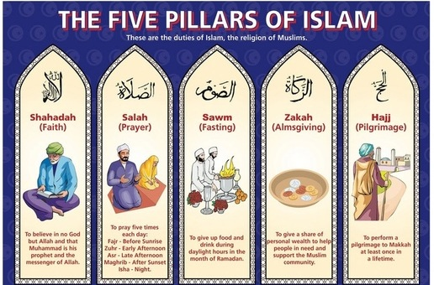
Why do Muslims fast during Ramadan?

Slide 3
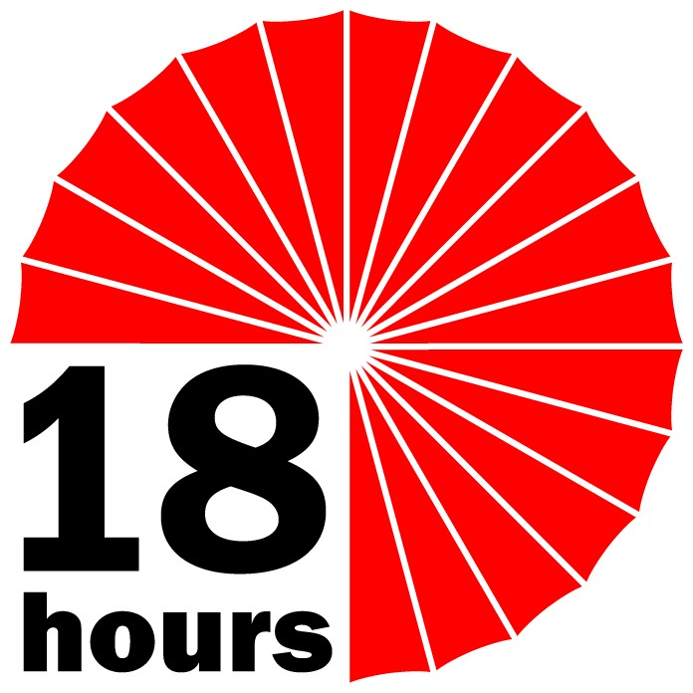
What does fasting involve?
The fast starts before sunrise: in May/June this will be around 3.00am
The fast breaks at sunset: in May/June this will be around 9.30pm

Slide 4
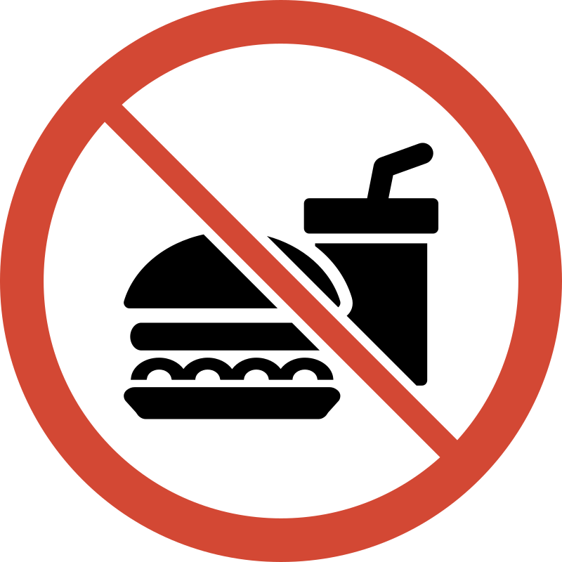
Muslims are NOT allowed to eat any food or drink, THIS INCLUDES WATER.
Smoking is a disgusting habit and nobody should smoke – however during Ramadan its is forbidden to smoke during the fast.
You can’t take any medicines – that’s why sick people are not allowed to fast.
The fast starts before sunrise: in May/June this will be around 3.00am
The fast breaks at sunset: in May/June this will be around 9.30pm
Notes:
https://www.youtube.com/watch?v=s-zZvH_mXTw

Slide 5
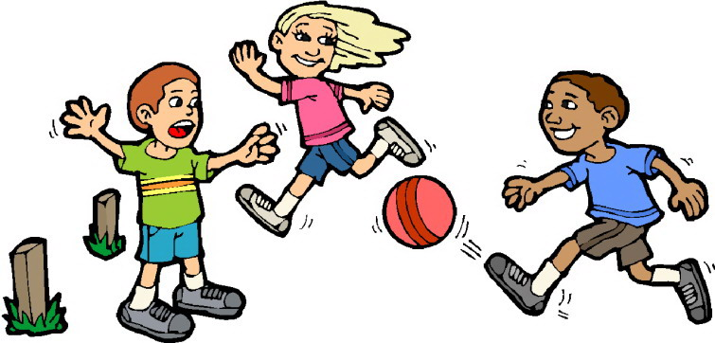
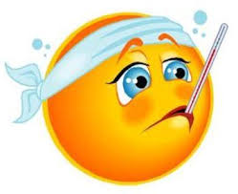
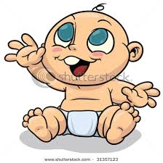
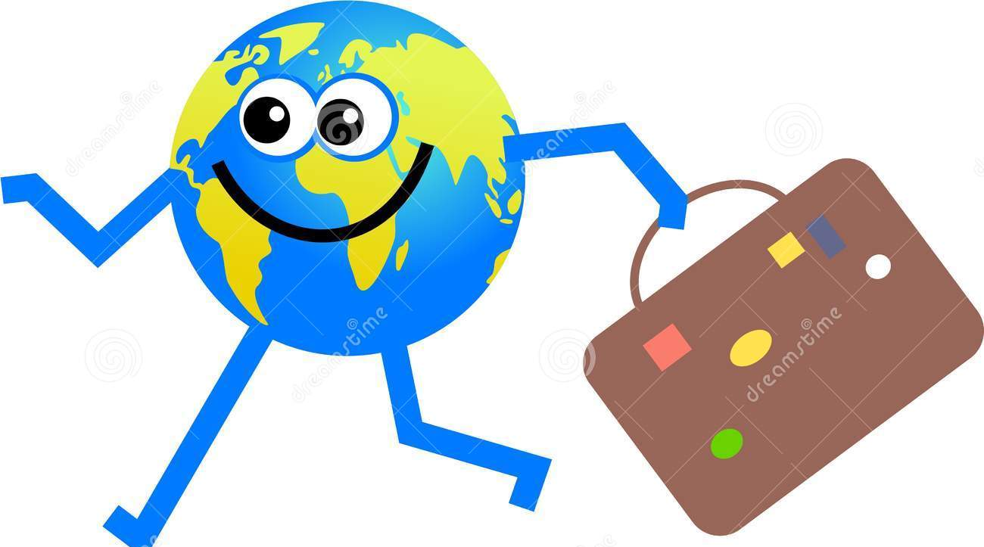
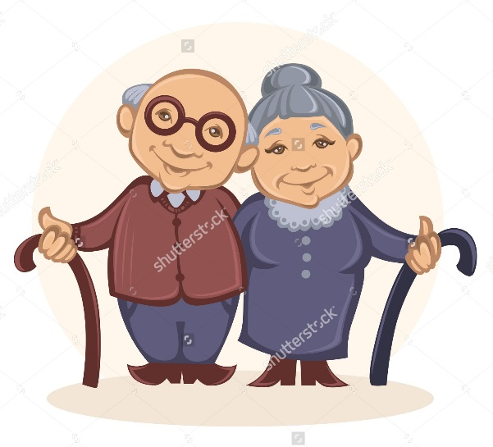
Young children
When you ill/sick
Pregnant women
Travelling (holiday out of your country)
Babies
Who is NOT allowed to fast?
Old people

Slide 6
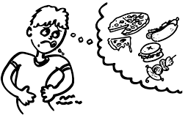
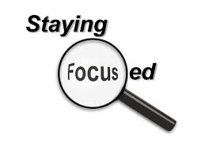
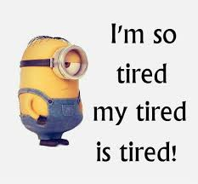
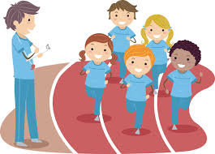
Remember: it’s a normal school day!

Slide 7
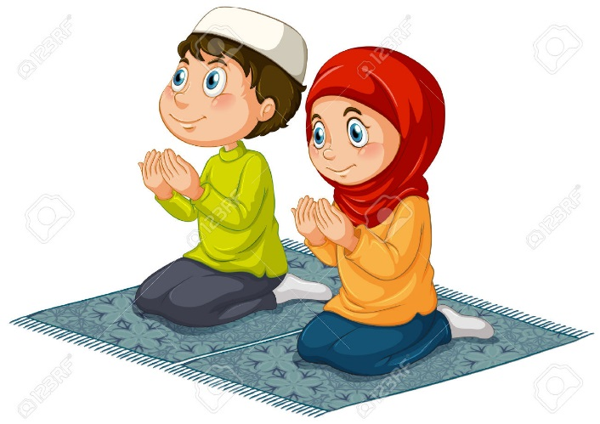
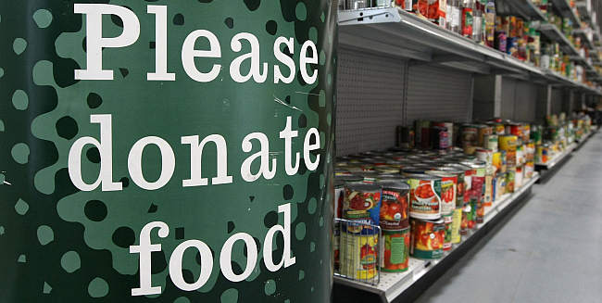
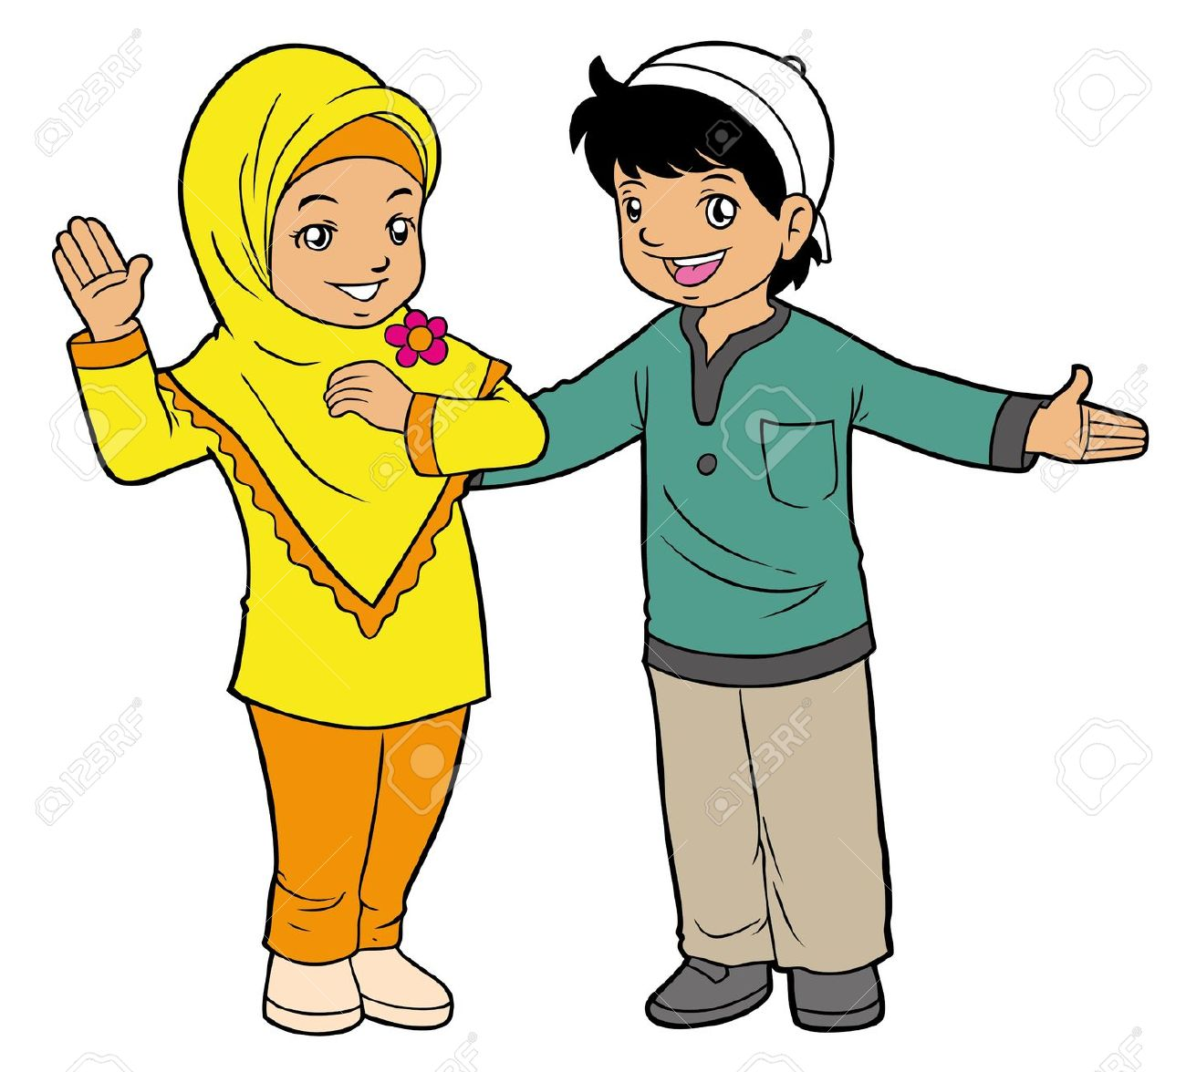
So…What can I do instead of fasting?

Slide 8
Please remember: that you don’t have to be Muslim or fasting to be kind, considerate and respectful to one another.
We can all try to be better citizens in our community and be a positive role model for others.

