Slide 1
Welcome to our Parents’ Forum
Wednesday 17th May 2017

Slide 2
Update on permanent site
New homework system
Parent communication
Facebook page
ESOL classes
Keep your child safe online

Slide 3
Permanent site
We will be moving into Phase One in January 2018
The final two phases will be ready by September 2019.
Building work has started.
No lockers on the new site.

Slide 6
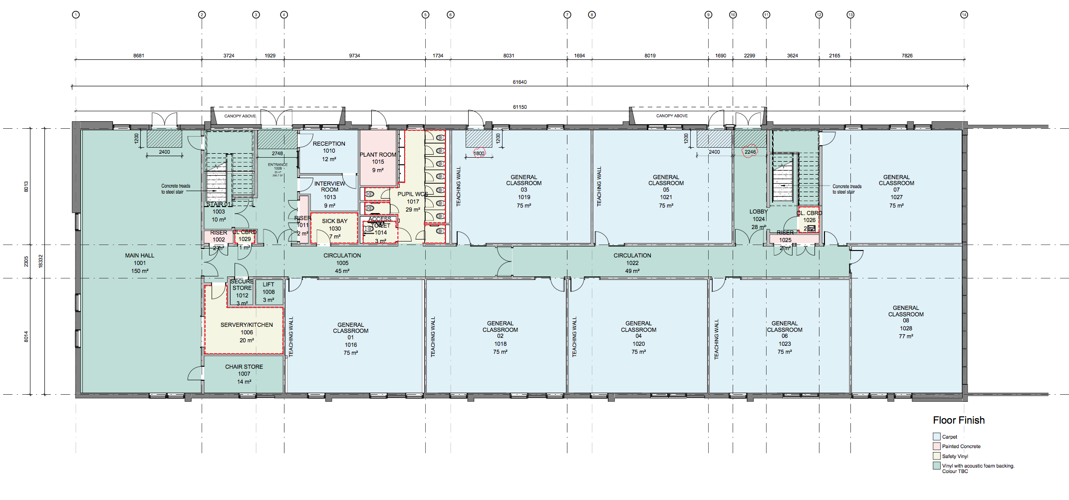

Slide 7
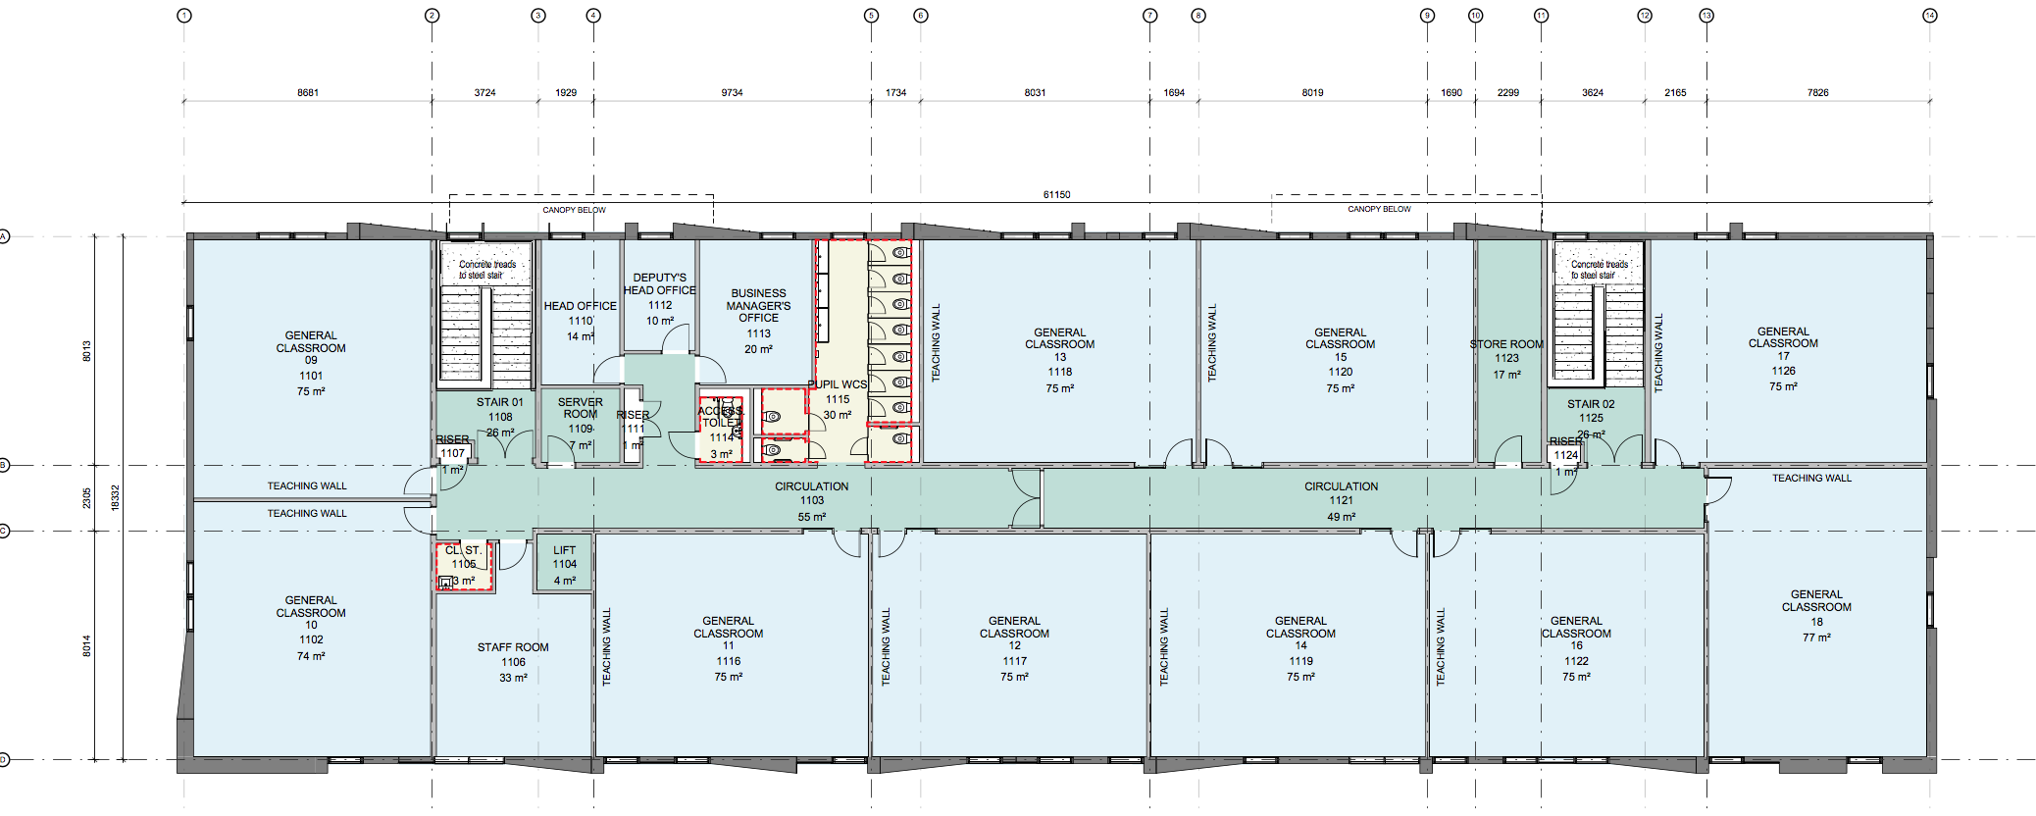

Slide 8
Homework
We will be using Show My Homework to set and record homework after half term.
This will allow parents to more easily monitor what homework has been set and when it is due.

Slide 9
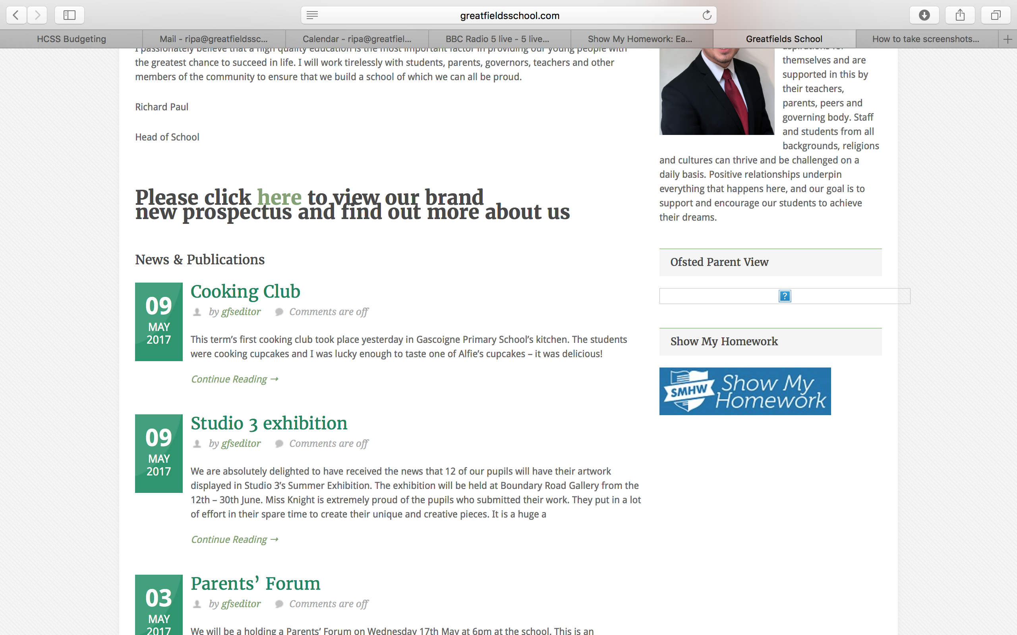

Slide 10
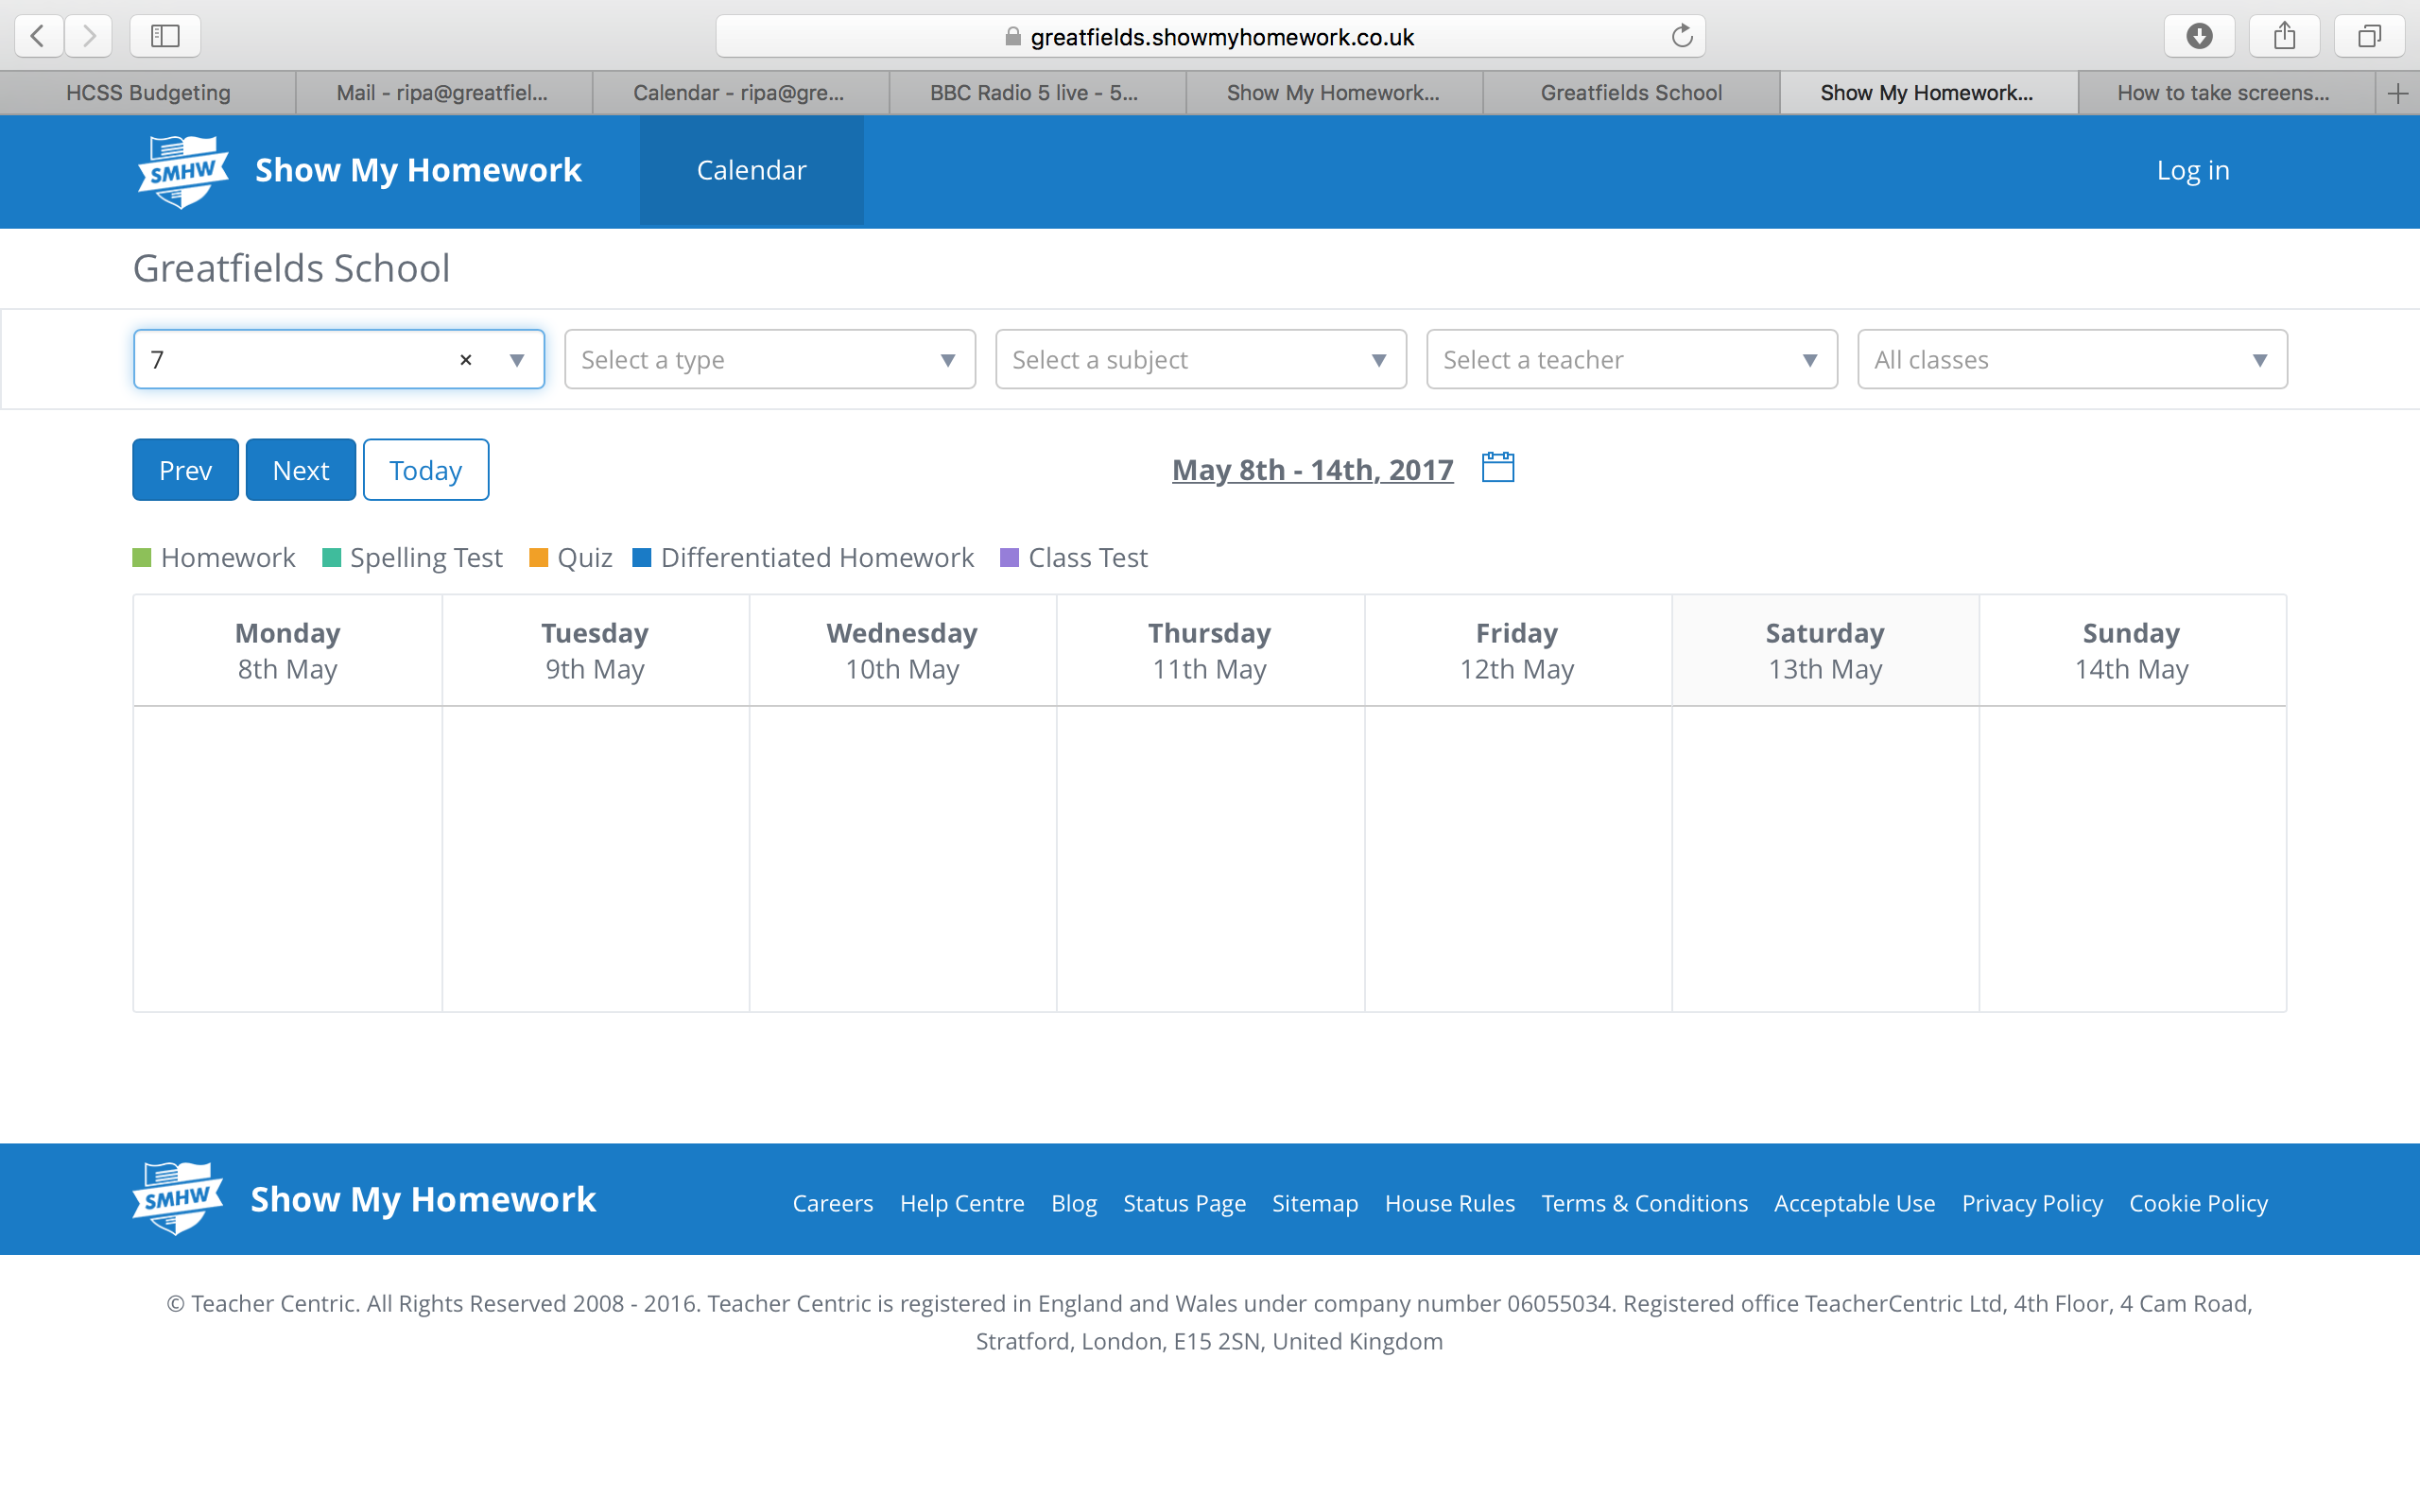

Slide 11
How much homework should you expect your child to be set?
Homework should be set once a week in every subject
The type of homework set will vary:
Reading
Spelling test
Quiz
Research/revision
Every three weeks a substantial piece of written homework will be set in each subject.
It is very important that students take homework seriously and complete it on time and to the best of their ability. Your support with this is very important.

Slide 12
How can we improve communication with parents?
Current forms of communication:
Website
Letters home (via students)
New texting service
Facebook page
Any other suggestions?

Slide 13
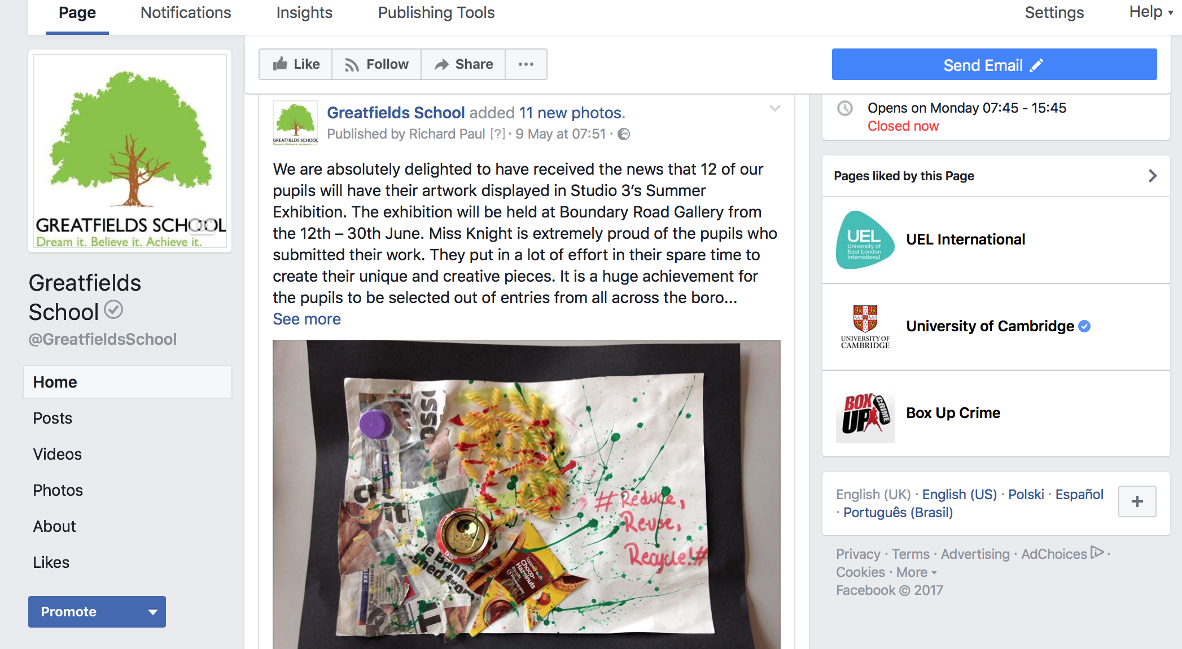

Slide 14
ESOL classes
We are offering free English classes to all of our parents
If you are interested please complete form and hand in to reception.

Slide 15
Online safety: Conversations to have with your child
Ask them to show you which social media apps they use and what they like about them. Talk about how they use them and what makes them so engaging
Explain how you can use privacy settings to make sure only approved friends can see posts & images
Check if any of their apps have ‘geo-location’ enabled, sharing their location unintentionally
Show them how to report offensive comments or block people who upset them
Check ‘tagging’ settings so that when others are posting or sharing photos online, your child’s identity is not revealed. Also, get people‘s consent before sharing photos
Encourage your child to come and talk to you if they see anything that upsets them

Slide 16
People may not always be who they say they are online: how can this create problems?
Why is it unwise to meet anyone in the real world that you’ve only ever met online?
Even if you think your messages are private, remember that words and images can always be captured and broadcast.
People present themselves differently online - do they really look like that? Are they always having that good a time?
Be aware that screens, and especially being anonymous, can lead people to say things they wouldn’t say to someone’s face.
What does being a good friend and a likeable person online look like?
There can be pressure to be part of a particular group online or to be seen to be following a certain set of ideas
How can you take a step back and make your own decisions?

Slide 17
Further Advice
NSPCC
https://www.nspcc.org.uk/preventing-abuse/keeping-children-safe/share-aware/
CEOP
www.thinkuknow.co.uk

